Slide 1
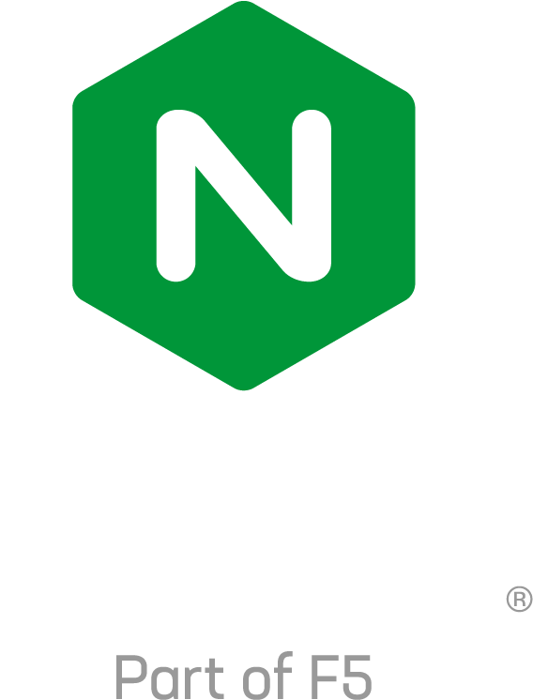


Run an Angular app locally
with Docker and Nginx
Drew Shirts
@drewshirts
Notes:
Hi! My name is Drew Shirts and I'll be sharing how to run an Angular app locally with Docker and Nginx ("Engine X").

Slide 2


Drew Shirts
@drewshirts
Software Engineer
Church of Jesus Christ of Latter-Day Saints
Notes:
A little about me: You can find me on Twitter @drewshirts. I’m a Software Engineer, currently working at the Church of Jesus Christ of Latter-Day Saints.

Slide 3
Tools
Node.js
NPM
Visual Studio Code (Or your preferred editor)
Docker Desktop
Angular CLI
Notes:
There are a few tools we'll be using for this presentation: Node, NPM, Visual Studio Code, Docker, and Angular CLI.

Slide 4
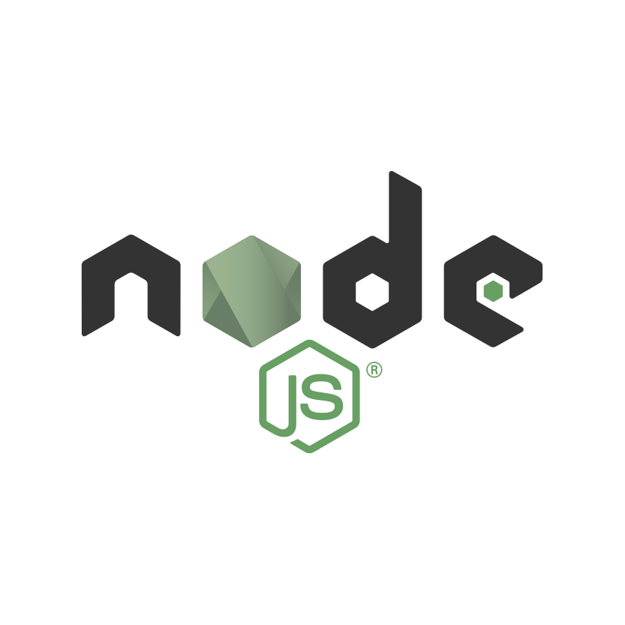

https://nodejs.org/en/download/
Notes:
We won't be covering the install of Node and NPM in this tutorial, but you can download both together at nodejs.org.

Slide 5

https://code.visualstudio.com/download
Notes:
I'll be using VS Code as the editor of choice for this tutorial.

Slide 6
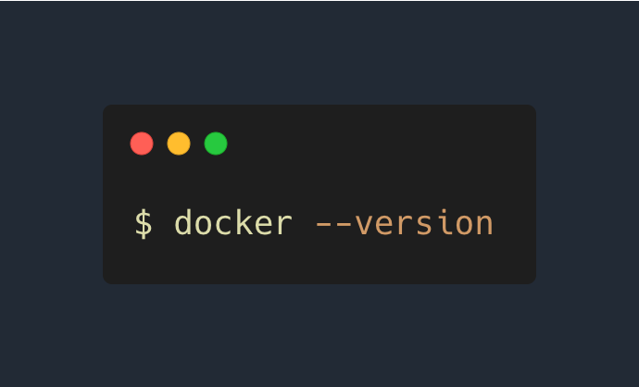
Docker Desktop
https://www.docker.com/products/docker-desktop
Validate install:
Notes:
Installing Docker Desktop will provide you with the CLI and the UI executables.

Slide 7
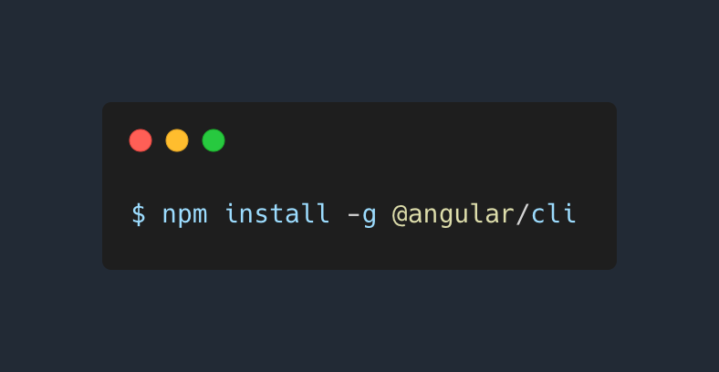
Angular CLI
Notes:
You can install the Angular CLI using this global npm command.

Slide 8
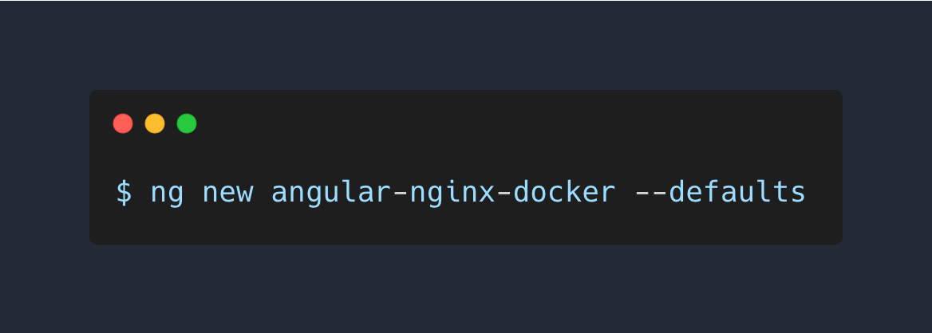
Angular App
Notes:
With these tools in place, let's create an Angular app with the default settings.

Slide 9
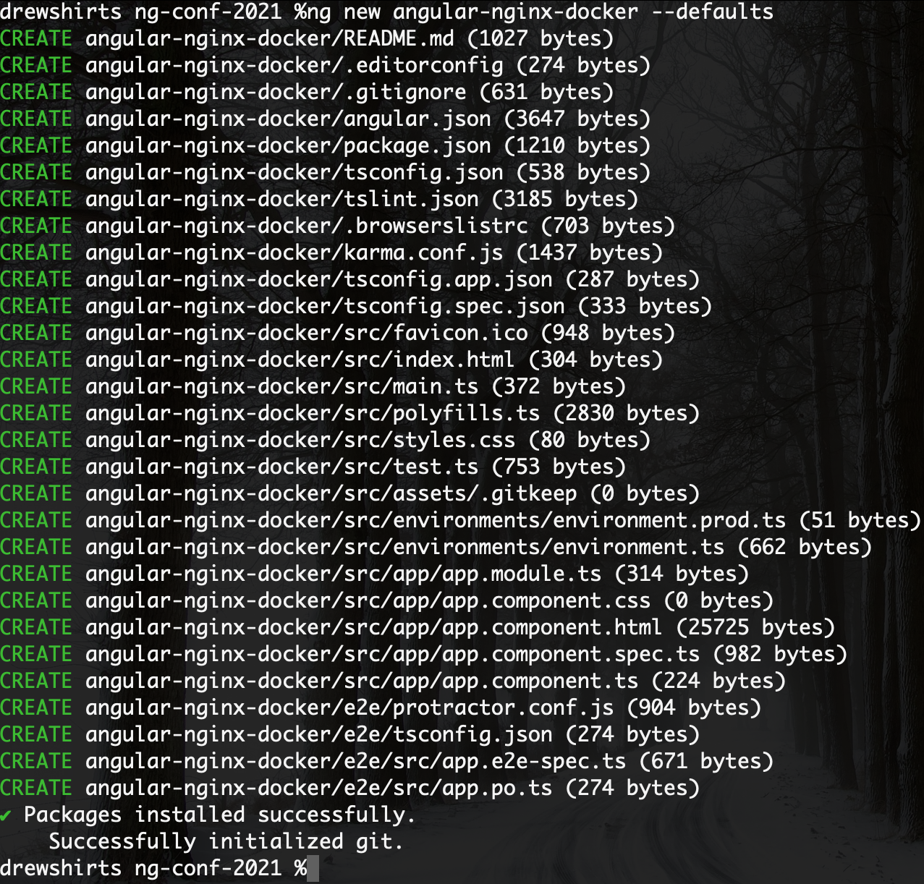
Notes:
After creating the default project, it will run npm install for you. Depending on your internet connection, it can take a while.

Slide 10
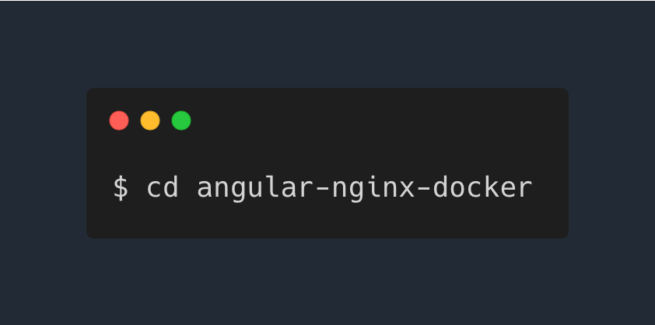
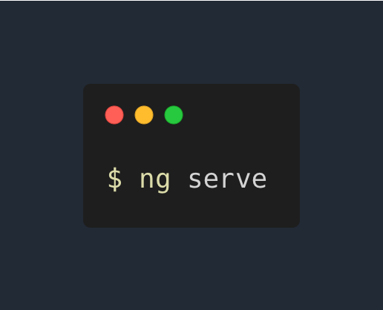
Angular App Validation
Notes:
Now, let's validate the angular app runs correctly with ng-serve.

Slide 11
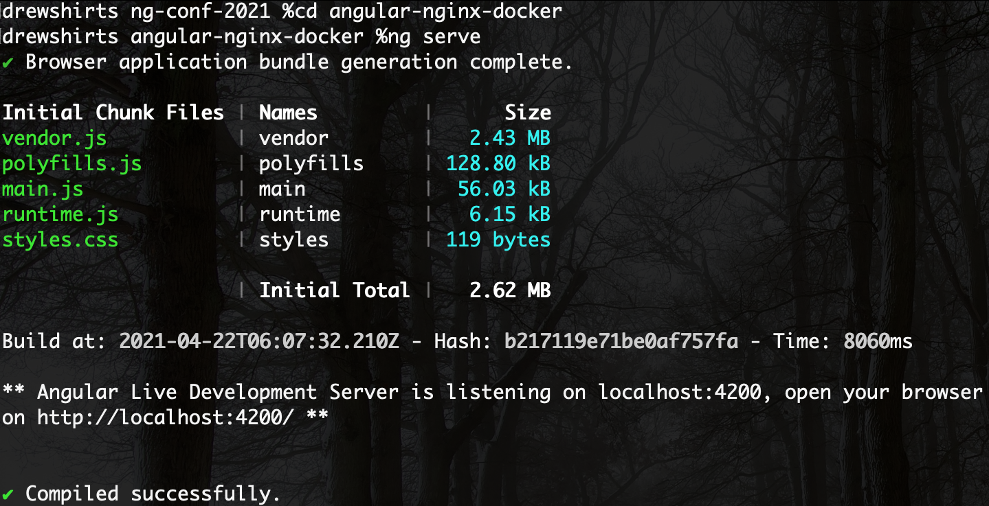
Notes:
Once the build and compilation complete, it will start the local server on localhost, port 4200. Let's open up the browser and take a look.

Slide 12
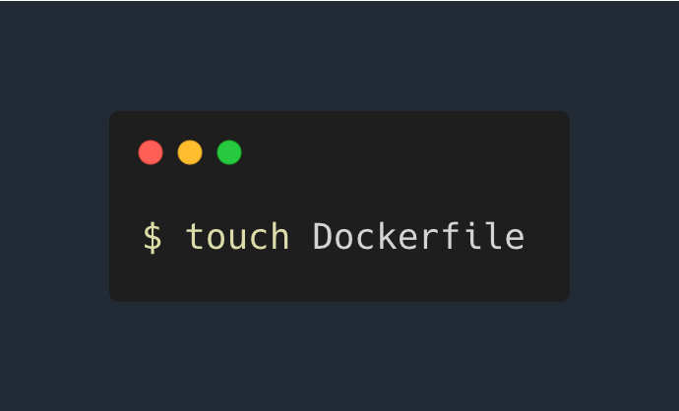
Docker setup: Dockerfile
Notes:
Create a file named ‘Dockerfile’. The init-cap and no extension are on purpose.

Slide 13
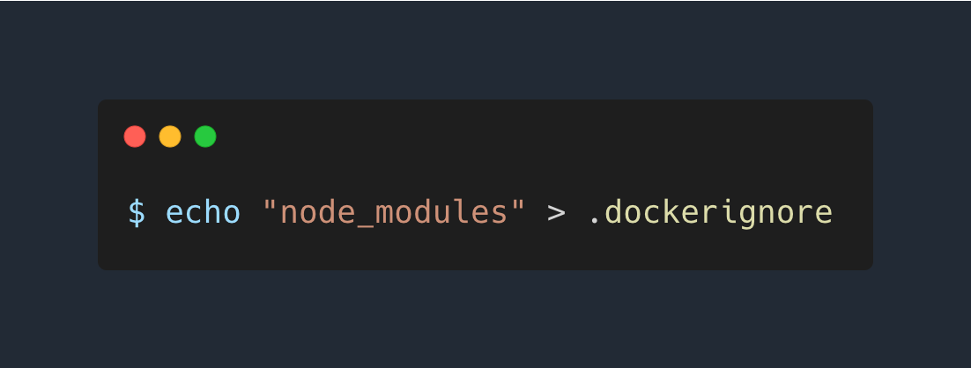
Docker setup: .dockerignore
Notes:
Create a file named '.dockerignore' and add the folder name 'node_modules’. This allows us to ignore our dependencies there just like we do with a .gitignore file.

Slide 14
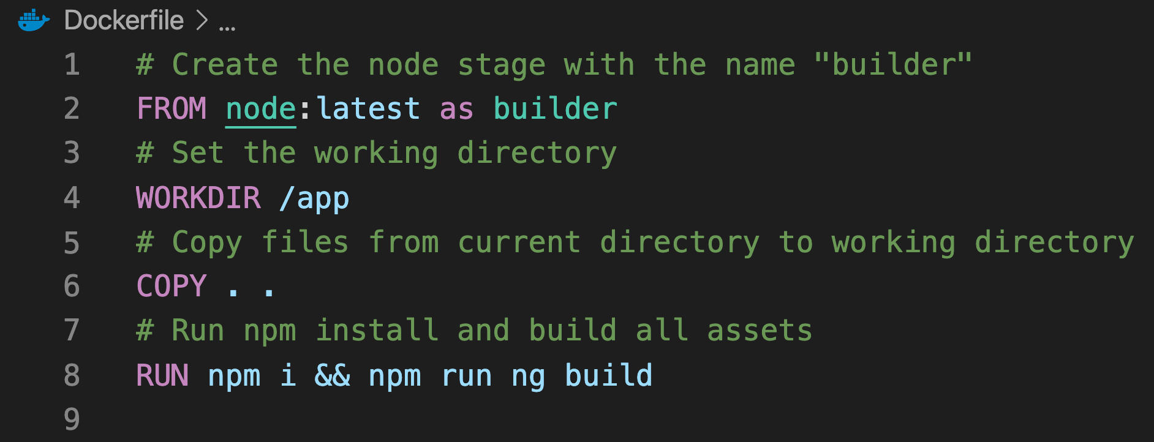
Docker setup: Dockerfile Node Stage
Notes:
We’ll be using a two-stage process for building out our Dockerfile. Our first stage will add a node image, copy all the Angular files to our working directory, run npm install to add project dependencies, and finally will build the app with npm.

Slide 15
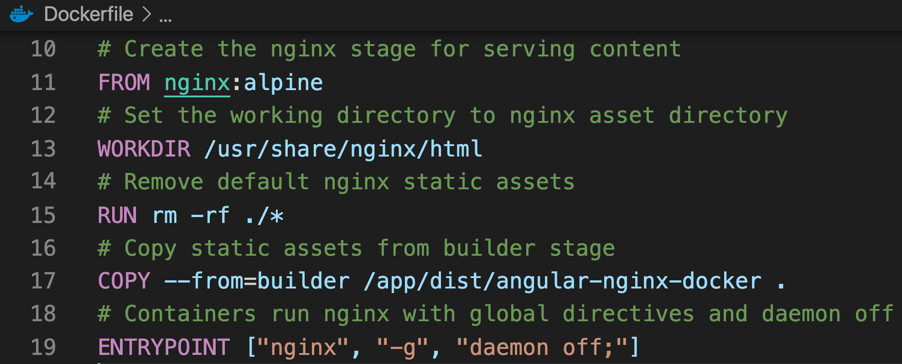
Docker setup: Dockerfile Nginx Stage
Notes:
Our second stage for our Dockerfile will use an nginx image, set the working directory for nginx assets, remove any default assets from the nginx image, copy our node static assets from the builder image we just created, and specify the entrypoint for our Docker container to run nginx. You can add an additional configuration file for nginx to match your local settings with those of lower test lanes and production, but for this exercise, I’ll keep it simple.

Slide 16
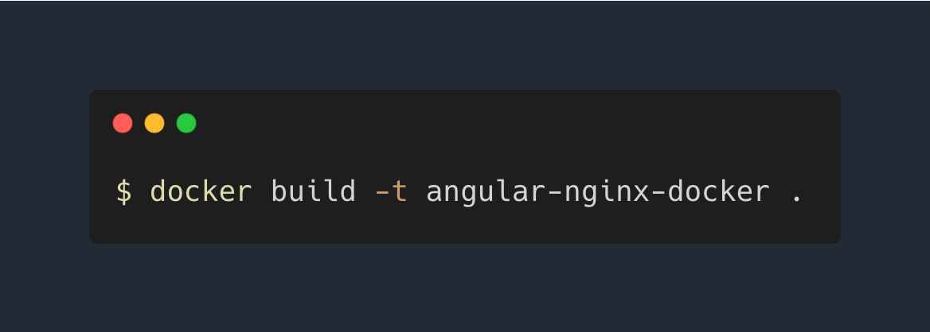
Build Docker Image
Notes:
With these two stages added to our Dockerfile, we are ready to build an image called 'angular-nginx-docker'

Slide 17
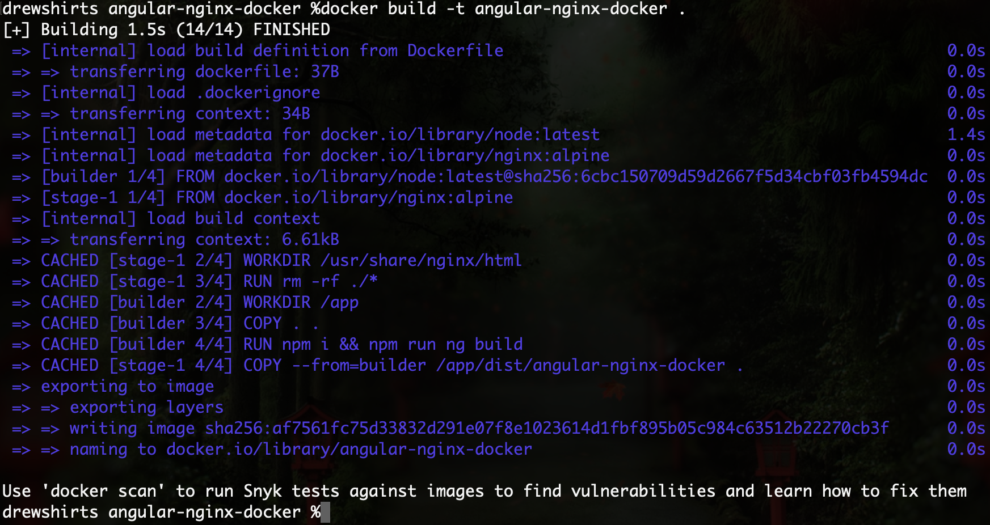
Notes:
The build completed will look like this.

Slide 18
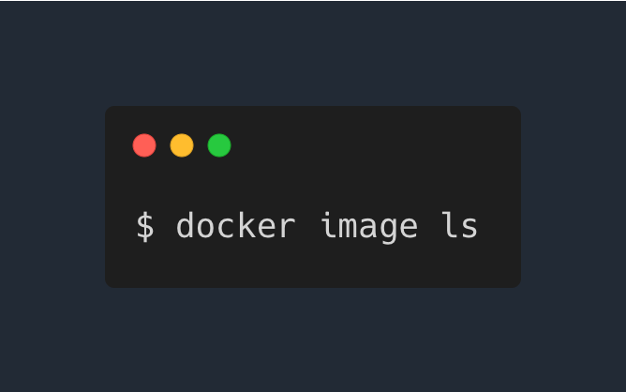
Docker Validation
Notes:
When the build is complete, you can validate the image was created with “docker image ls”. It will show all the Docker images you have on your computer.

Slide 19
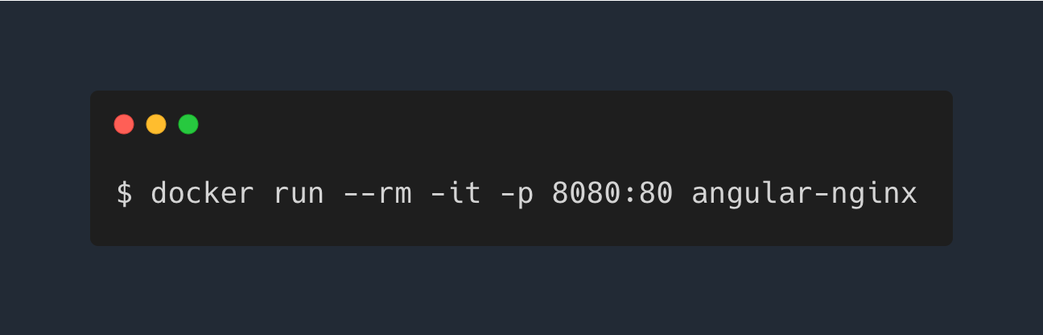
Docker Startup
Notes:
Building complete, enter when ready. Now we can start a container, serving up our app on localhost, port 8080.

Slide 20
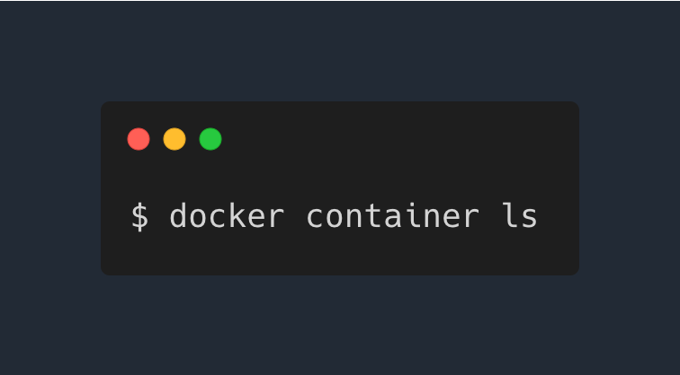
Docker Startup Validation
Notes:
After the container is up and running you can see which containers are up with “docker container ls”.

Slide 21
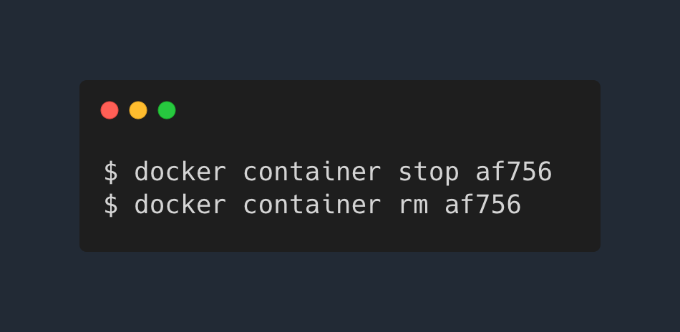
Docker Management
Notes:
When you make changes to your Angular app, you will need to create a new docker image. Use these when the container is still running. The hash at the end of these commands is the sha256 hash created when the container is built.

Slide 22
Thank You!!
Drew Shirts
@drewshirts
Software Engineer
Church of Jesus Christ of Latter-Day Saints
Notes:
Thank you for your time today! I’m glad I’ve had this opportunity to share. It has helped me learn a lot about using Docker and Nginx. I plan on using this with my current projects at work.

